Slide 1


ECCOM Network System Co.,Ltd.
Company Profile (2022 Edition)
Unlock Insights and Boost Agility, Accelerate to the Digital Future

Slide 2

CONTENTS
01
OVERVIEW
02
BUSINESS ABILITY
03
ECCOM SERVICES
04
CORPORATE CULTURE

Slide 3
OVERVIEW

Slide 4

ABOUT ECCOM
22
Years
7.3
Billion
2,620
Employees
26
Offices
98
Overseas Cities
53
Countries & Regions
Professional IT service experience
Revenues in 2021
The number of worldwide exceeds
Offices nationwide
Over 90 overseas cities worldwide
Professional services delivered
The Trusted IT Partner of Digital Transformation
Provide solutions and services in the fields of network, cloud, security and industry digitalization, etc.
Extensive industry customer base: finance, operators, enterprises, governments, transportation, education & medical care, Internet, energy, broadcasting & TV

Slide 5


SCALE
Deliver quality services to 50% of Top 100 Chinese Enterprises
With 2,620 employees, including
Founded in 2000
The average annual revenue growth exceeds 15%
300+
190+
2100+
Sales Force
Management Support Staff
Technical Staff

Slide 6

LOCATION
East China
1190 employees
North China
420 employees
Beijing
South China
440 employees
Shanghai
Southwest China
400 employees
Chengdu
Wuhan
Central China
120 employees
International Area
Shenzhen
Others
50 employees
North America, Singapore, Germany，Hong Kong
Guangzhou
南海诸岛

Slide 7

OVERSEAS
Service delivered in
32
cities of Europe
STOCKHOLM
HELSINKI
GOTHENBURG
MOSCOW
ENSCHEDE
MANCHESTER
ZWOLLE
DUBLIN
AMSTERDAM
WARSAW
LONDON
DUSSELDORF
BRUSSELS
FRANKFURT
HAMBURG
VANCOUVER
MONTREAL
PARIS
MUNICH
ZURICH
LUXEMBOURG
SEATTLE
TORONTO
BERN
GENEVA
VIENNA
ALMATY
PORTLAND
BOSTON
Service delivered in
22
cities of North America
MARSEILLE
MILAN
SOPHIA
NEW YORK
MADRID
BARCELONA
ROMA
ISTANBUL
SILICON VALLEY
CHICAGO
PHILADELPHIA
SEOUL
SAN JOSE
DENVER
ASHBURN
WASHINGTON DC
BUSAN
TOKYO
ISLAMABAD
SHANGHAI
OSAKA
LOS ANGELES
DALLAS
ATLANTA
KARACHI
ROSARITO
DUBAI
DELHI
TAIPEI
98 overseas cities, 53 countries & regions, covering six continents
MIAMI
FUJAIRAH
MUSCAT
KAOHSIUNG
Service delivered in
10
cities of Middle East & Africa
MUMBAI
YANGON
MACAO
HANOI
HONGKONG
VIENTIANE
MANILA
North America: 22 cities
Europe: 32 cities
Asia: 25 cities
Africa & Middle East: 12 cities
Oceania: 4 cities
South America: 3 cities
Covering 16 time zones globally
BANGKOK
LAOS
PHNOM PENH
ABUJA
DJIBOUTI
HO CHI MINH
LAGOS
ADDIS ABABA
KUALA LUMPUR
NAIROBI
CYBERJAYA
SINGAPORE
Service delivered in
3
cities of South America
Service delivered in
12
cities of Middle East & Africa
MOMBASA
JAKARTA
Service delivered in
29
cities of Asia-Pacific
JOHANNESBURG
SAO PAULO
RIO DE JANEIRO
CAPE TOWN
SYDNEY
SANTIAGO
MELBOURNE
AUCKLAND

Slide 8
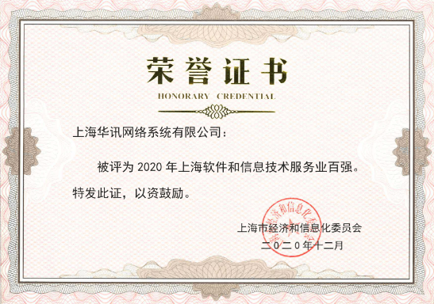

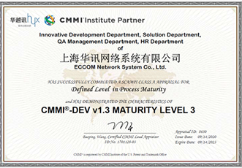
QUALIFICATIONS AND HONORS
ITSS Level-1 certification
CNIETS-1
CMMI Level-3 certification of software
Information security service qualification certificate - information system security integration service qualification
Information security service qualification certificate - information security risk assessment service qualification
ISO9001 quality management certification
ISO27001 information security management system certification
ISO20000 information technology service management system certification
Ranked at No.7 among the " Evaluation of Core Competitiveness of Shanghai Software Enterprises in 2021"
Won the title of the "2021 Shanghai Top 100 Software and Information Technology Services" granted by the SHEITC
Ranked at No.55 among the " China Top 150 Software Companies in 2021"
Having won the "Outstanding Contribution Enterprise Award for Scientific and Technological Innovation" granted by the People's Government of Pudong New Area successively every year
AAA level enterprise credit rating

Slide 9






























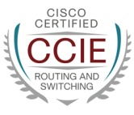
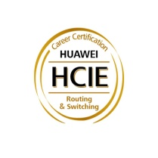












PROFESSIONAL CERTIFICATION
The Company has passed over 1,700 technology certifications of various types,
covering all aspects of full-stack IT
Application layer: data application /DevOps/ software development…
80+
200+
Project Management and Service Management
Software infrastructure layer: software definition/container/operating system/middleware/database/disaster recovery & backup…
270+
150+
Information Security and Application Delivery
Hardware infrastructure layer: network/storage/server…
1000+

Slide 10


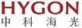






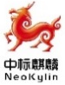













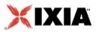






















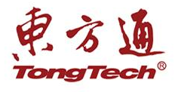

PARTNER ECOSYSTEM
Global
Domestic
Cloud
IT Innovation

Slide 11






























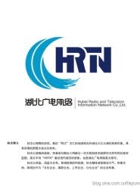





















CUSTOMERS
Finance
Operators/
Internet
Enterprises
Governments/
Public Utilities

Slide 12
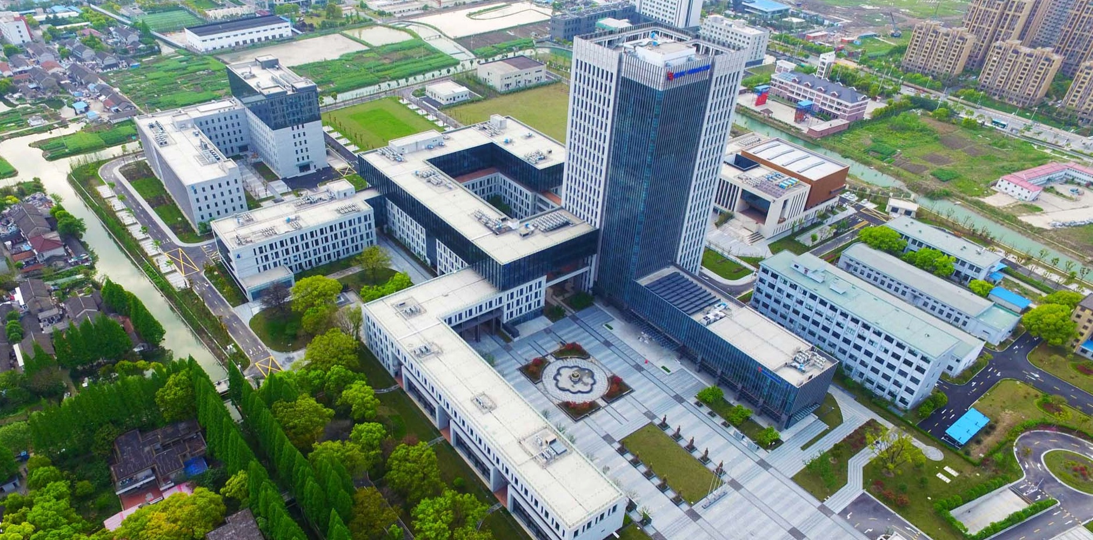
GROUP INTRODUCTION
Shanghai East China Computer Co.,Ltd. is the controlling parent company of ECCOM. As the first listed IT company in mainland China, its actual controller - China Electronics Technology Group Corporation and the major stockholder - CETC No.32 Research Institute, are strong in technical strength, with independent and controllable innovation ability, able to provide great support to ECCOM's business innovation, transformation and upgrading.
CETC
CETC Digital Group/
No. 32 Research Institute
East China Computer
East China Computer
Headquarters
ECCOM
ECDATA
Trusit

Slide 13


























CAPACITY LAYOUT
Systems
Taiji | CETC | ECDATA
Smart City
GovCloud
Industry Applications
Smartdot OA | Taiji WE
Supporting software
Industry application
Supporting Software
CETCLOUD One Stack | CETCLOUD One Data
Basic Software
iSoft OS | Ruihua OS | King Base | Apusic
Basic software
CETC Sunway
Research Institute
Secure firmware
Network Security
Westone
Machine equipment
Standard module
Complete Machine Modules
Huacheng Jinyue | CETC No.32 Research Institute | Prophet | CETC No.52 Research Institute
Security Firmware
CETC
Guowei Tiancheng
Core Chips
CETC Sunway | China Key System | CETC No.32 Research Institute

Slide 14
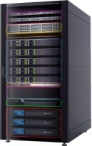


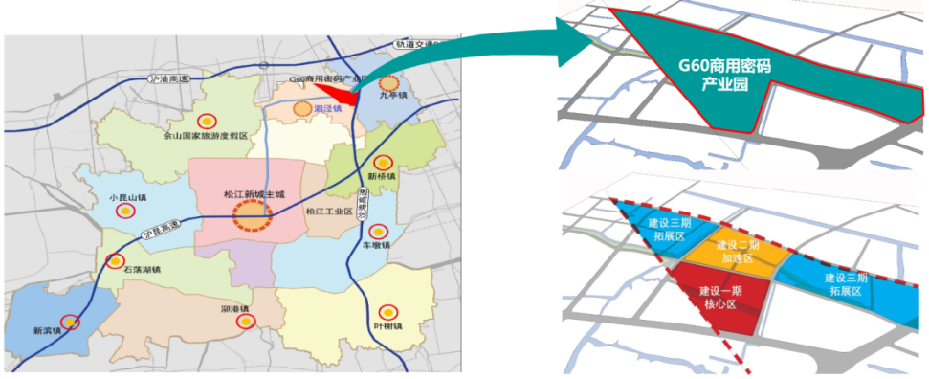

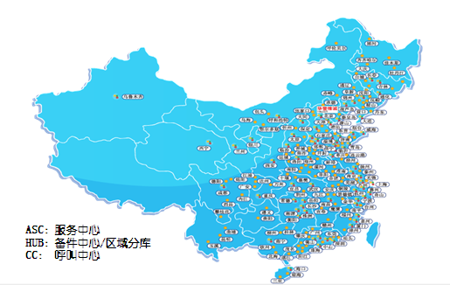

INDUSTRIAL LAYOUT
Industry information technology solution provider
Taking ECCOM as the main body
A well-known information technology solution provider in the financial industry of China, enjoying a wide customer base and extensive integration experience in various industries and sectors.
Integrated
Delivery
Sunway server R&D production base
Taking Huacheng Jinyue as the main body
Building an independent and controllable server product R&D system and a supply chain delivery system to support IT innovation projects and smart city data center construction
Financial IT Innovation Joint Research Base
Product R&D
Songjiang IT Innovation Industrial Park
Taking CETC as the main body
Optimization of upstream and downstream depth adaptation of joint industrial chain
Export complete solutions for applications in the financial IT innovation field, building an industrial ecosystem
Adaptation Research
National after-sales service network
Service Assurance
Taking Trusit as the main body
Build an after-sales service network and a technical support system to support the industrial landscape of server products and CETC IT innovation
Financial cloud base
Industrial Application
Taking East China Computer as the main body
Aiming to promote financial IT Innovation and new-generation information infrastructure industrial applications
Building capabilities in data center construction and cloud service operation
With the investment of about RMB 3 billion, the expected output values in 2020, 2022 and 2025 will be RMB 2 billion, RMB 10 billion and RMB 30 billion respectively.

Slide 15
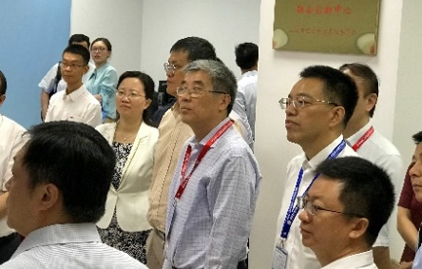
JOINT RESEARCH BASE
Award of Joint Research Base
On September 19, 2019, under the guidance of the leaders from the Ministry of Industry and Information Technology of the People's Republic of China and the Shanghai Economy and Information Committee, the "Shanghai Financial Information Technology Application Innovation Joint Research Base & Shanghai Financial Application Technology Joint Innovation Center" was established at East China Computer. This is the first domestic joint research base in the field of financial IT innovation. According to the construction goal, four laboratories will be built in the joint research base. Upon the completion of the laboratories, a leading state-level financial IT application innovation sci-tech industrial base with clear positioning, scientific management, open sharing, diversified investment and distinctive technical features will be initially formed
Construction of 4 Laboratories
Research Laboratory of Financial Localization Technical Index and Design Specification System | Financial Localization Adaptation Laboratory | Financial Emerging Technology Localization Laboratory | Financial Evaluation Laboratory

Slide 16
BUSINESS ABILITY

Slide 17












TRINITY OF INDUSTRY DIGITALIZATION ARCHIECTURE
With data and intelligence leading, we strive to integrate the cloud with the network and achieve trustworthiness; We work to build a full-stack digital foundation for the "network of things, data, and intelligence" and the digitalization-intelligence system, thus empowering our customers in their course towards digitalization.
Intelligence
Hospitals
Finance
Businesses
Country
Security Frame & Solutions
Education
Public Utilities
Internet of Operators
Governments
Safety Service & Operation
Water Projects
Open Application
Transportation
Factories
Parks
Digitalization
Recognition Algorithm
Reasoning Training
Data Masking
Data Classification
Business Situation
Multi-source Data Acquisition
Integrated Universality
Data Empowerment
Data Management
Digital Twins
Business Modeling
Networking
Cloud
Terminals
Edge
Edge
Terminals
Data Center
……
Enhanced Sharing
Sensors
Intelligent Operation
IOT
Data Base
Middleware
Network
Servers
Storage
Docker

Slide 18






LEAD
Smart Transportation
Intelligent O&M
Business Intelligence
Intelligent Collaboration
Scenario Application
Data Empowerment
Prediction Optimization | Anomaly Detection | Business Insight | Intelligent Identification
Data Access and Governance
End
Data Center
Cloud
Application
Digital Fundamentals
Splunk>

Slide 19









CONVERGENCE
SaaS
PaaS
Computation
Storage
Network
IoT
Application Modernization
Data Distribution
End
Network
Dedicated Line
SD-WAN
Data Center
Network
Edge Cloud
Hybrid Cloud
Network
Public Cloud
/Private Cloud
Edge
Cloud
Network
Cloud computing
Cloud intelligence
Software Definition
Core Network/Campus Network
5G/Access Network
Distributed/Hyper-Converged Infrastructure
Software-defined Data Center
Industry-specific Cloud
Build Cloud Native Application
Agile Application/DevOps
IntelligentPerfect Cloud MSP Service

Slide 20



TRUSTED
Classified Protection& Industry Compliance
Security Transformation Driven by Making Businesses Go on Cloud
Offense-defense Confrontation & Drill
Online Business Availability & Data Security
Intelligent Security Service
Solution
Safe Operation
Compliance Consultation
Local Deployment
Basic Protection
Pre-defense
Vulnerability Scanning
Post-audit
Offense-defense Confrontation
Cloud Security
Basic Protection
Interim Response
Emergency Response
Security Management | Vulnerability Management | Privileged Account Management | Traffic Analysis | ID Authentication
Application & Data Security | Web Application Protection | Database Protection | Data Encryption | Container Security
Infrastructure Security | Next-generation Firewall | DDoS Protection | Intrusion Detection | Terminal Protection

Slide 21
ECCOM SERVICES

Slide 22



1+2+N
ECCOM INTELLIGENT PERFECT SERVICE SYSTEM
Service Scenarios
N
Service Scenarios
Data Centers | Hybrid Clouds | Core Networks | Smart Campus | Industry Applications
IntelligentIntegration Integration Service | IntelligentMaintenance Maintenance Service | IntelligentOperation Operation Service
IntelligentConsultation Consultation Service | IntelligentOptimization Optimization Service | IntelligentSecurity Security Service | IntelligentPerfect Cloud Service
Service Operation Methodology
2
Approaches
“PPDIOO”
Full Life Cycle Specialized Service
"LAER Customer Success"
Continuous Service
1
Engine
ESE Intelligent Service Engine
Being Intelligent in Ideas
Digitally and Intelligently Driven
Customer Experience
Being Perfect in Practice
Process Guarantee

Slide 23











SERVICE SOLUTIONS
20-year industry-wide professional service experience
With service resources covering 20+ major cities in China
Full IT Infrastructure
Integration of Data
Center
Insights into Infrastructure
Operations
Analysis & Optimization
Hybrid Cloud Environment
Business Migration
IT Infrastructure O&M Service of Enterprises Going Global
Multiple-branch IT Hosting Service
Enterprise IPv6 Application Transformation Consultation & Implementation Service
A customer-focused advanced service operation system
1000+ mainstream certified full-stack IT service engineers
Public Cloud MSP
Cloud Migration Service
Cloud Consultation & Planning Service
Cloud Lean Optimization Service
Cloud Native Application Development Service

Slide 24
ESE SMART SERVICE ENGINE
Link Delivery
Responsive | Active | Preventive
ESE Smart Service Engine
Being Intelligent in Ideas: Digitally and Intelligently Driven
Customer Experience
Being Perfect in Practice: Process Guarantee
Analytical Application
Software Tools | Knowledge & Experience | Expert Team | Delivery System | Control Process
Collection Records
Service Data | Best Practice | Industry Standards

Slide 25
SERVICE METHODOLOGY
Life Cycle Methodology of Specific Support
Design
Implement
Landing
Continuous Service
Adoption
Test & Verification
Planning & Design
Implementation & Delivery
Purchase
Advocate/Promotion
Purchase
Advocate/Promotion
Consultation & Planning
Migration & Change
Recommendation
CS Consultation Service
PS Specialized Service
Analysis & Evaluation
Evaluation & Optimization
Choice
Update
Plan
MS Outsourcing Service
SS Support & Maintenance
Operate
Customers
Specialized Service
Acceptance
Optimization
Operation & Management
Hardware Maintenance
Evaluation
Use
Adoption
Need
Realize
Participate
Need
Realize
Participate
Running Management
Technical Support
Renew
Expand
Prepare
Optimize

Slide 26
PROFESSIONAL & AGILE
SERVICE ORGANIZATION
Industry Customers
Sales Team
Producers
Partners
Business Support & Development Team
"Iron Triangle"
Industry/Regional Delivery Team
Support
Business Scenarization
Empower
Service Middle Platform
Competence Center
Pre-sales Service Center | Advanced Service Center | Hosting Service Center
Overseas Service Center | Integration Service Center | TAC Center
Industry Solution Center | All-IT Technology Competence Center
Software Capability Middle Platform
Customer Success
Knowledge Management
Data Empowerment
Process Optimization
Customer Success & Platform Department

Slide 27
CORPORATE CULTURE

Slide 28




CORE VALUES
Commitment is a kind of responsibility and a win-win attitude
Encourage and advocate all ECCOM employees to keep a good mindset and the courage to innovate in their work
Always take achieving common goals as the first priority
Realize a win-win result between enterprises and customers, enterprises and employees, and create a stable and mutually beneficial cooperative relationship

Slide 29



CULTURE IMMERSION
Traditional Culture
Activities
Annual meetings, essay contests, league construction, clubs, sporting events, parent-child activities …
Communication
Freetalks, rationalization proposals, app platform construction…
Innovation Culture
Innovation & Incubation Mechanism
DT Workshop
Management Lecturer class

Slide 30
ECCOM · The Trusted IT Partner of Digital Transformation
We strive to deliver unprecedented value to our customers in network, cloud, security and digital transformational services.

Slide 31
THANK YOU

